Slide 1


Model-based testing
Project Group 9 – Software Quality
Kaan Akbulut (7328725), Johannes Simon (7364536)

Slide 2
Table of Contents
Introduction
Background
Overview of Model-Based Testing (MBT) and TiGL
Methodology
Choice of Method
MBT Tool Selection Criteria
Results
MBT Workflow
MBT Tool Selection & Test Cases
Modelling Prototype
Running Tests
Personal reflection

Slide 3
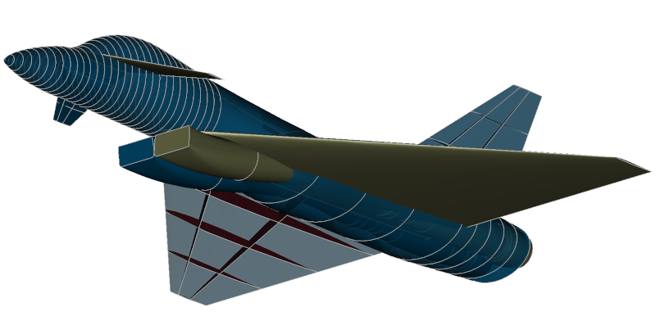
Introduction
https://dlr-sc.github.io/tigl/images/Fighter.png

Slide 4
Introduction
Motivation
Testing software systems is one of the most demanding and important tasks in development (Marinescu et al., 2015, p. 91)
Manually written tests can be incomplete and time-consuming, especially in industry (Marinescu et al., 2015, p. 91)
Model-Based Testing (MBT) to be used for automated test designs and generation (Schieferdecker, 2012, p. 14)
Potential benefits of MBT could be huge (Schieferdecker, 2012, p. 14)
There are still cases, such as the software TiGL, where MBT has not yet been used
Goals
Evaluate and prototype how MBT can be used for testing the software TiGL
Evaluate which MBT tool is suitable for this purpose
Research Question
Which MBT tool is suitable for testing the software TiGL?

Slide 5
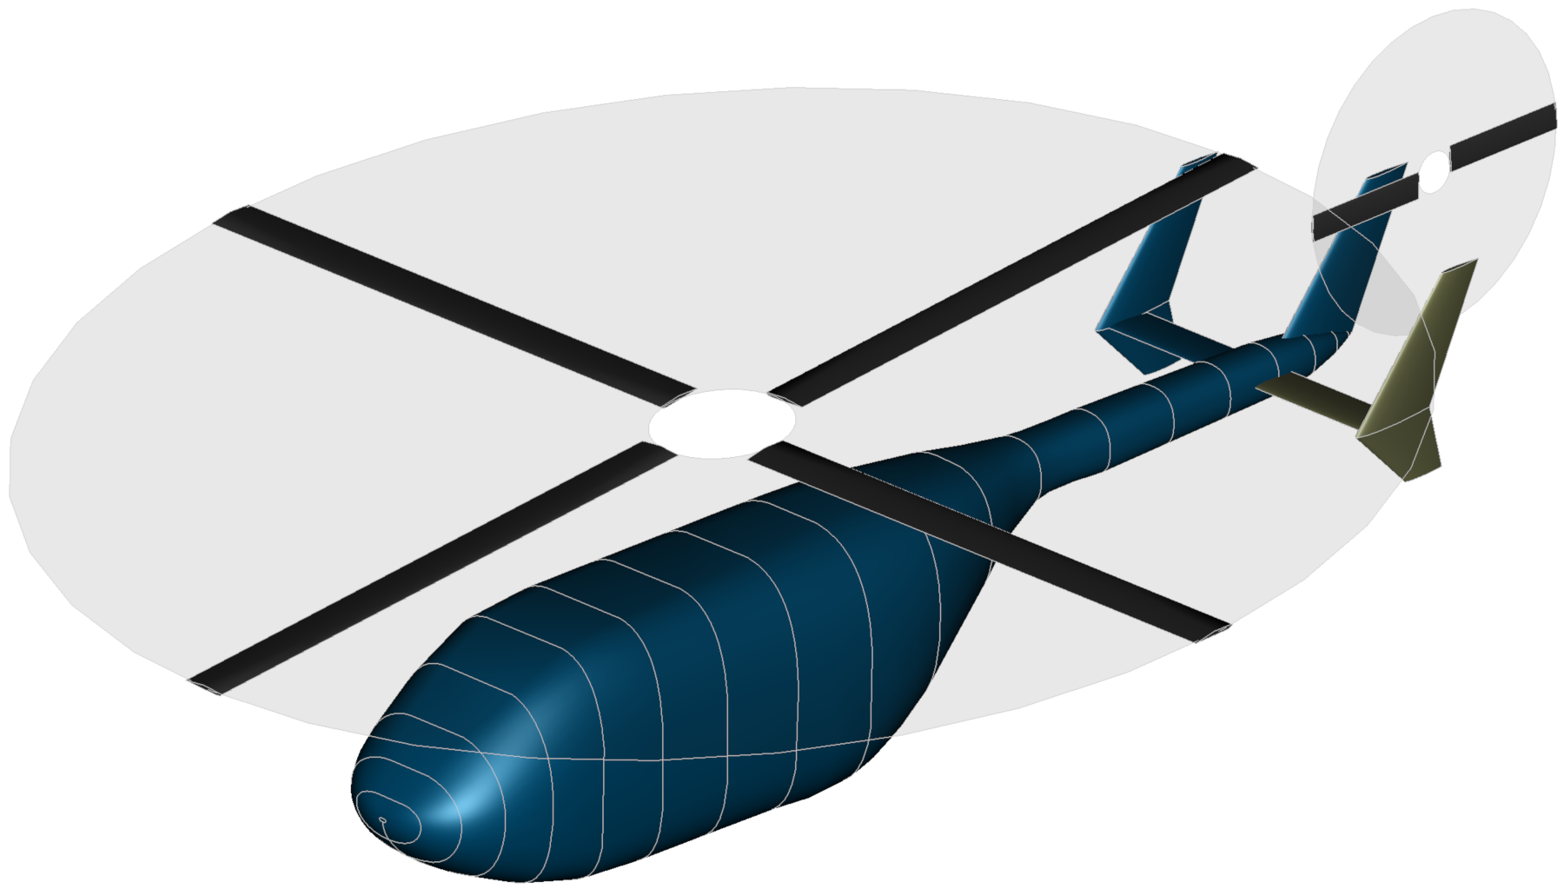
Background & Methodology
https://dlr-sc.github.io/tigl/pages/images/screenshots/SimpleHeli-HighRes.png

Slide 6
Background
Model-Based Testing (MBT)
MBT aims to automatically generate and execute test cases by utilizing an abstract system model (Marinescu et al., 2015, p. 91)
This model represents the behavior of the system under test (Utting et al., 2012, p. 297)
Type and appearance of models can differ based on domain, context, or purpose (Alégroth et al., 2022, p. 2)
TiGL
Open source geometry modeler used for aircraft design analysis and optimization (Siggel et al., 2019, p. 367)
Creates three-dimensional airplane shapes using a standardized parametric description (Siggel et al., 2019, p. 367)

Slide 7
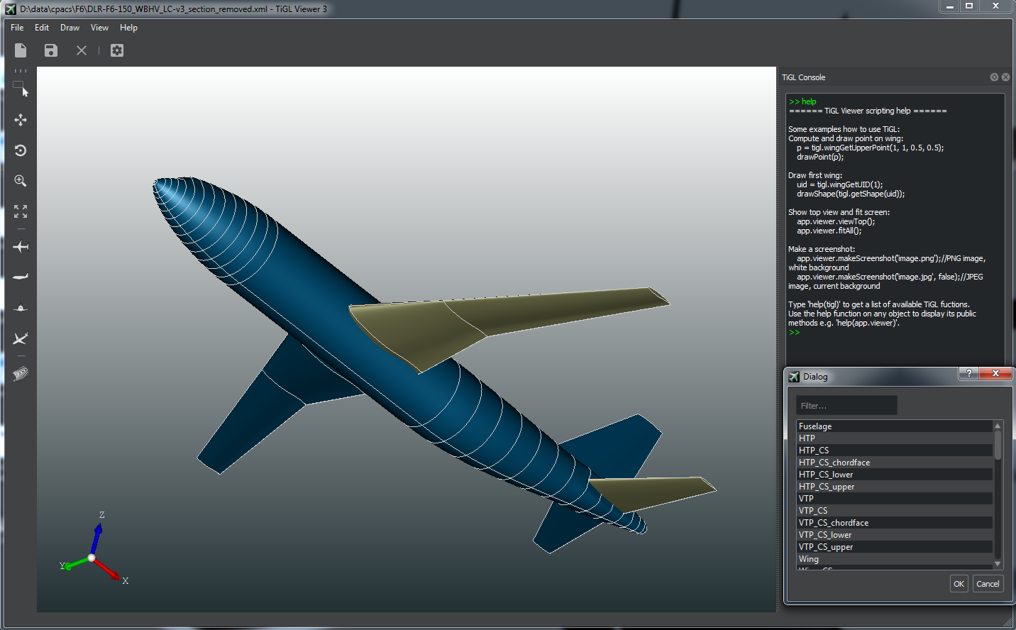
Background
https://dlr-sc.github.io/tigl/pages/images/screenshots/TiGLViewer-HighRes.png
https://dlr-sc.github.io/tigl/images/tigl-logo.png

Slide 8
Methodology
Choice of Method
Prototyping
Create initial test models
Web Search Research
Finding and comparing MBT tools
Search in Google
Interview with one of the TiGL developers
Semi-structured interview
TiGL developer: Jan Kleinert
Integration of Findings
Prototyping outcomes, interview insights, and research findings
Online Scientific Database Research
Broad search in Google Scholar, ResearchGate and IEEE Explorer
Paper Analysis
Defined criteria for MBT tool selection

Slide 9
Methodology
MBT Tool Selection Criteria (Marinescu et al., 2015)
Technology: Programming language, Online/Offline Testing, Testing system (Mobile, Desktop)
Licensing: Commercial or Open Source
Modeling notations: State-based, Transition-based, Stochastic, Data-flow
Artifacts: Functional behavior, Extra-functional behavior, Architectual description
Test selection criteria: e.g. Requirements-based coverage, Ad-hoc test case specification
Test generation method: Graph search, Model-checking, Manual, Random
Mapping: Abstract test, Executable test

Slide 10
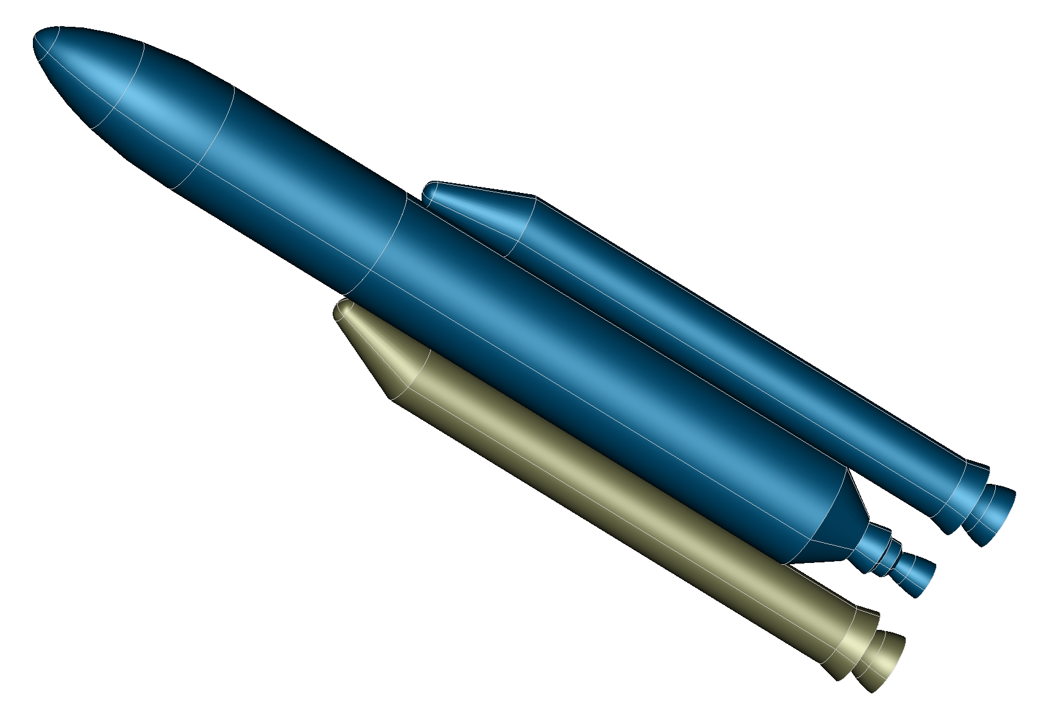
Results
https://dlr-sc.github.io/tigl/pages/images/screenshots/Ariane5-HighRes.png

Slide 11
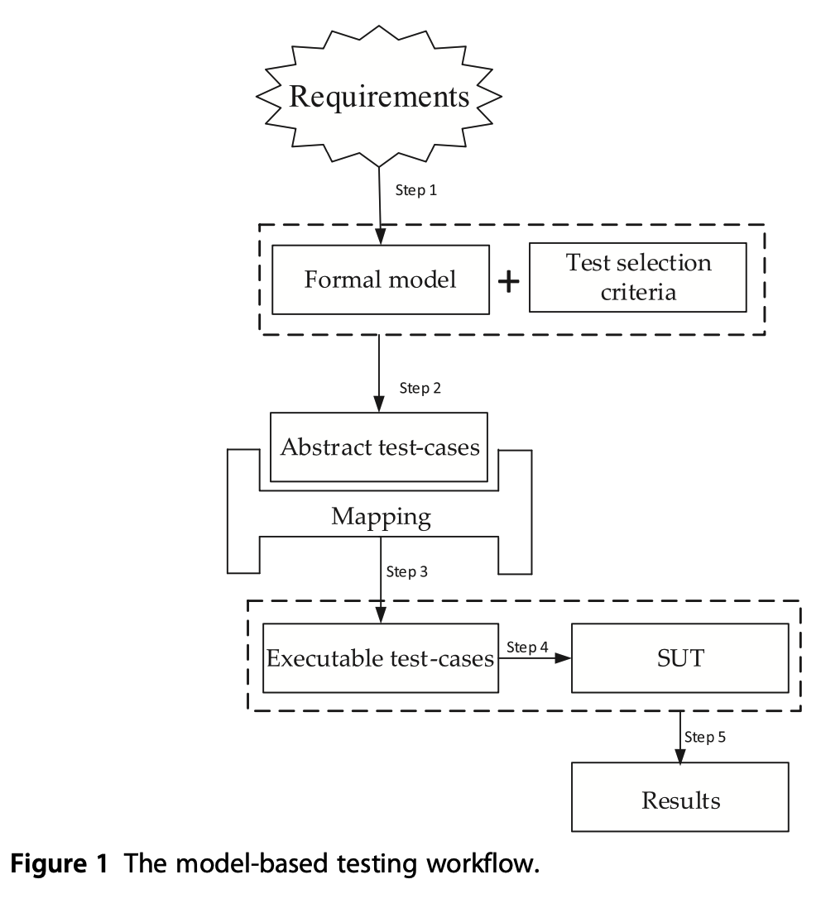
MBT Workflow
Step 1: Requirements of TiGL for ourselves
Step 2: Test selection criteria: Requirements-based
Step 3: Two abstract test-cases
Step 4: Mapped in TiGL with selected model
(Step 5: Execute test-cases)
Decision for GUI-Testing:
Improving User experience
Increased reliability
Especially for TiGL: Lack of GUI Testing
(Marinescu et al., 2015, p. 94)

Slide 12

MBT Tool Selection
- GraphWalker
GraphWalker is an open-source MBT tool (https://graphwalker.github.io/)
Models (graphs) to define and navigate through different paths of a system
Automatic generation of test sequences from graph models (Finite State Machines (FSM) and directed graphs)
Ensures comprehensive test coverage through systematic path traversal
Models are represented as graphs, where nodes are system states, and edges are transitions between states
Supports Java, JavaScript, Python, C# and Groovy
https://automated-360.com/wp-content/uploads/2021/10/text-description-automatically-generated.png
Institut für Softwaretechnologie
Notes:
Direkt erklären anhand der Eigenschaften, warum wir GraphWalker genommen haben. Bessere Doku, besseres GUI, einfachere Installation, bedingt kompatibel, open-source, automatische test generation.

Slide 13
Test Cases
Test case No. 1: Open and Display Model
Prerequisites:
TiGL Viewer is installed
There is a valid model that can be tested
Expected results:
Application opens without errors
The selected model is successfully loaded
TiGL closes properly
Test Steps:
Start the TiGL Viewer
Verify that the application opens properly
In the menu, select the "Open File" option
Navigate to a valid model and select it
Verify that the model is successfully loaded
Close the TiGL Viewer

Slide 14
Test Cases
Test case No. 2: Select and Rotate Component
Prerequisites:
TiGL Viewer is installed
There is a valid model with components that can be tested
Expected results:
Selected component is highlighted
Rotation of component is displayed correctly
TiGL closes properly
Test Steps:
Start the TiGL Viewer and open a model
Select a component in the model
Check whether the component is highlighted
Rotate the component
Check that the rotation is correctly applied
Close the TiGL Viewer

Slide 15
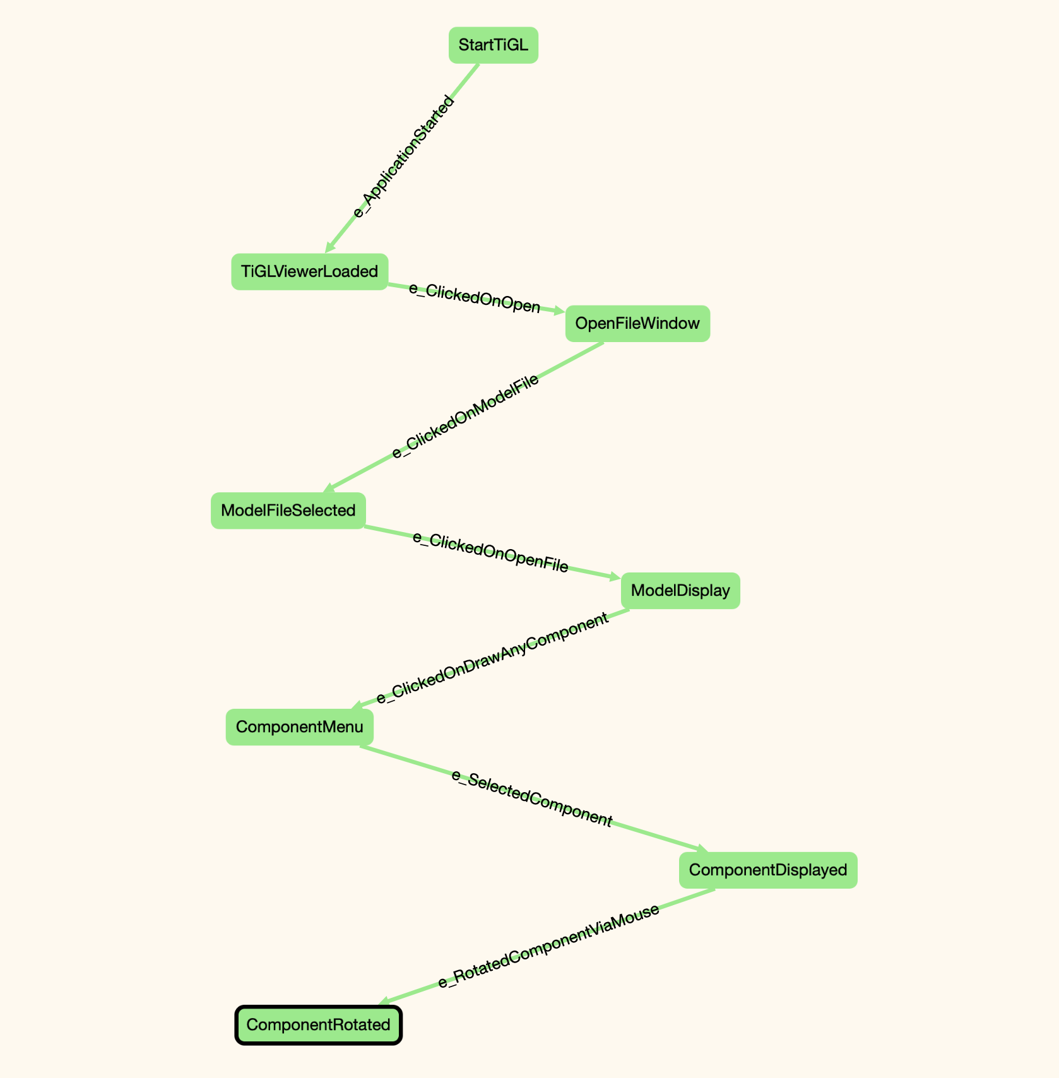
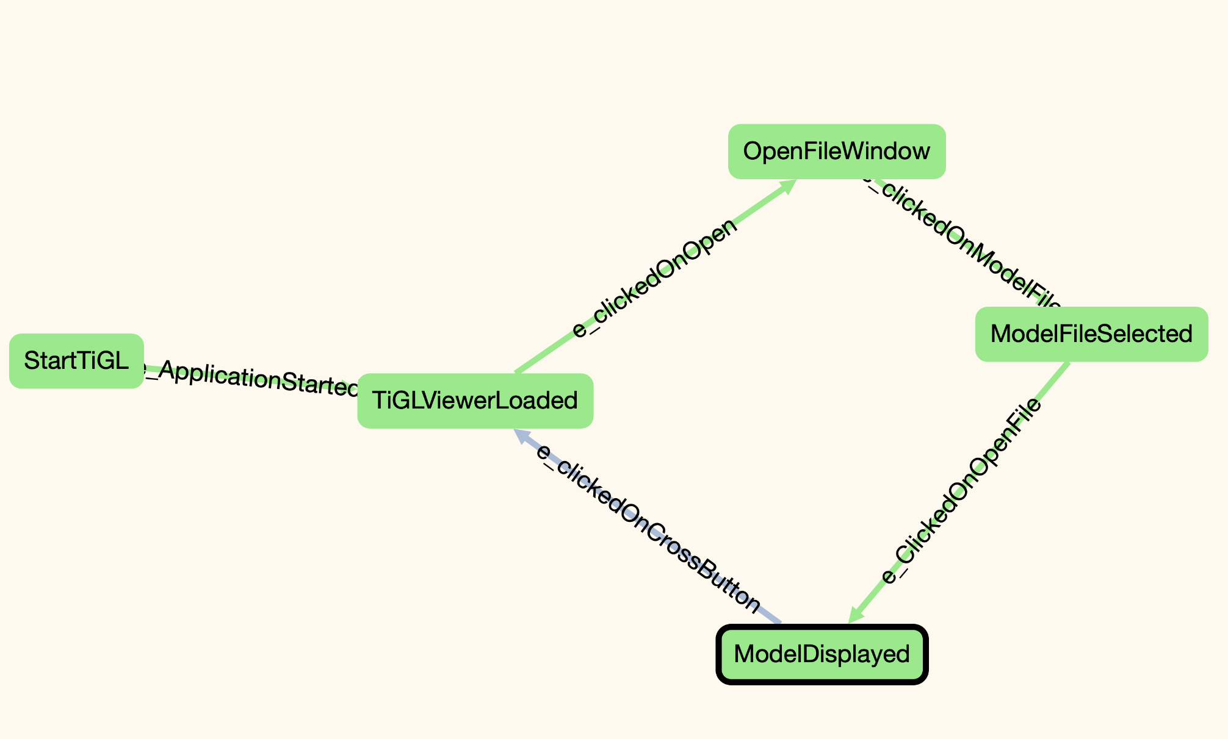
Modelling Prototype
Test case No.2
Test case No.1

Slide 16
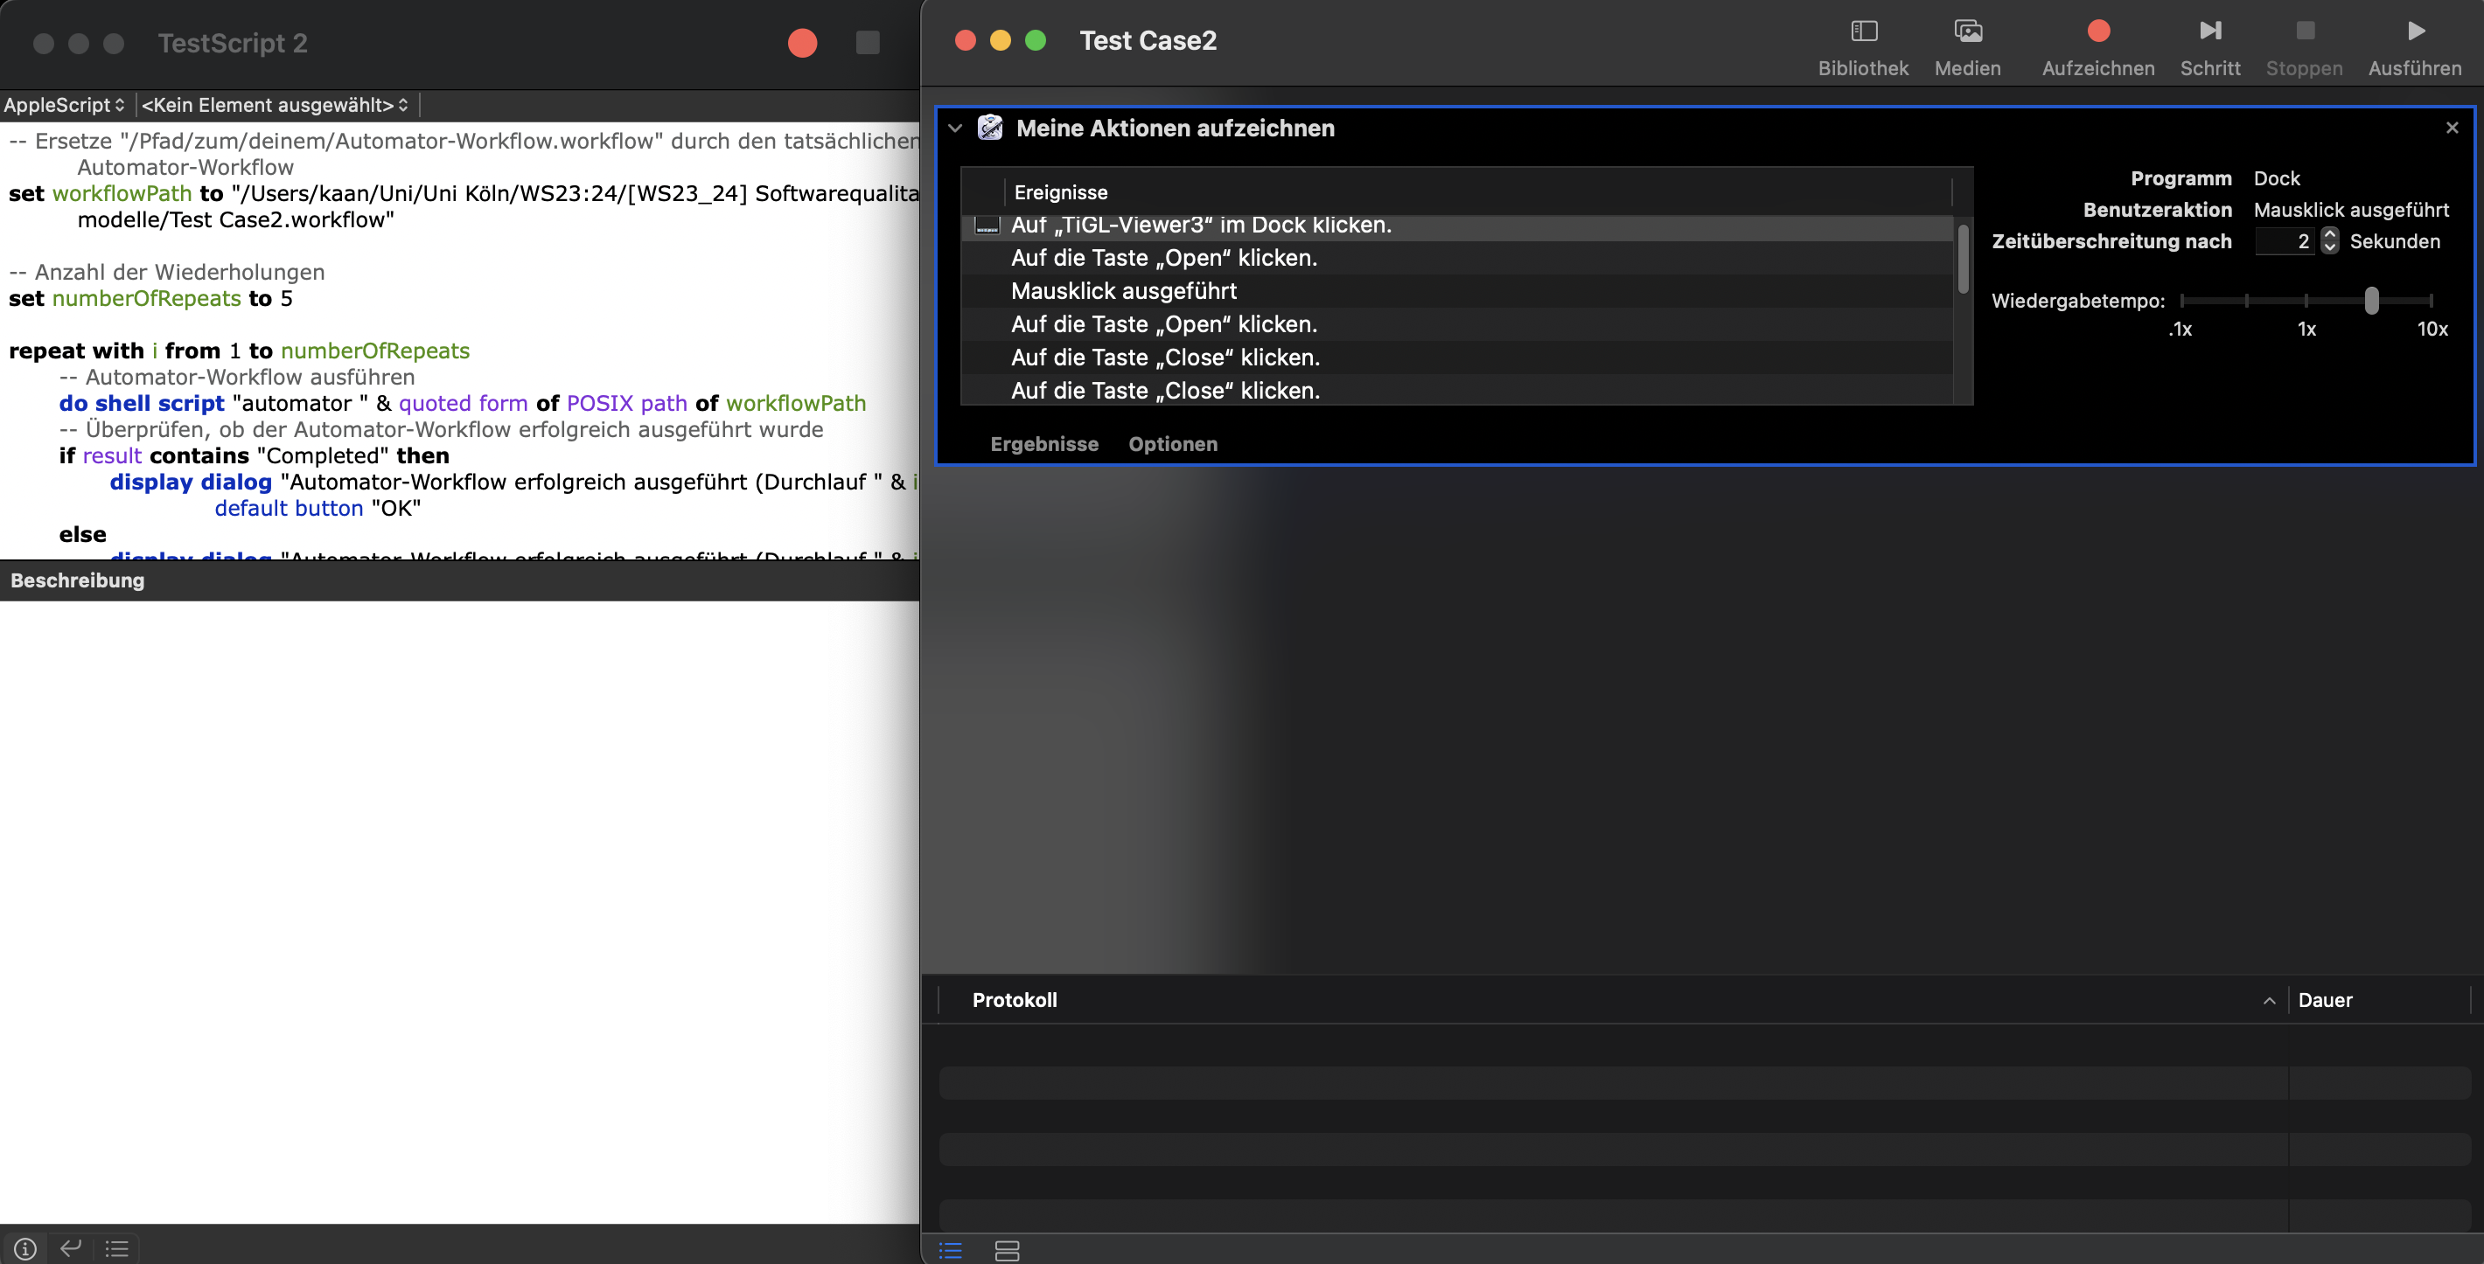
Running Tests
Two Test Cases are realized with Apple Automator/AppleScript
Multiple execution possible
Prototype Demo

Slide 17
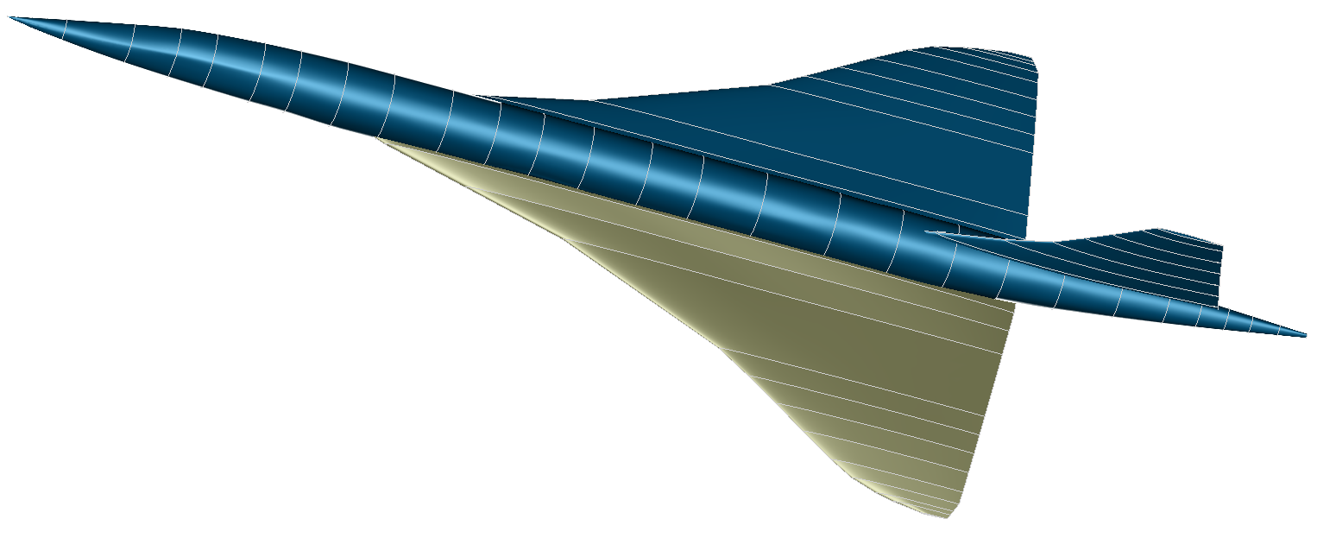
Personal Reflection
https://dlr-sc.github.io/tigl/pages/images/screenshots/Concorde-HighRes.png

Slide 18
Personal Reflection
MBT is an interesting topic that can make software testing much easier
Finding MBT tools is easy, but it requires effort and cautious selection of criteria to choose the "right" tool depending on the context of the system and the project
It also requires effort to get used to the selected tool; some tools provide examples and guidelines that can help with this
Overall, we now have a better overview of MBT, its variety of tools and its huge potential in the field of software quality

Slide 19
Sources
https://github.com/DLR-SC/tigl
https://medium.com/@yugene1986/what-is-model-based-testing-db3ebde10683
https://graphwalker.github.io/
Aho, P., N. Menz, T. Räty, and I. Schieferdecker. “Automated Java GUI Modeling for Model-Based Testing Purposes,” -1, 2011. https://publica.fraunhofer.de/handle/publica/372769.
https://www.rroij.com/open-access/model-based-testing-considering-steps-levels-tools-standards-of-software-quality.php?aid=37065
https://www.softwaretestingmagazine.com/tools/open-source-model-based-testing-tools/
https://ieeexplore.ieee.org/document/9155667
I. Schieferdecker, "Model-Based Testing," in IEEE Software, vol. 29, no. 1, pp. 14-18, Jan.-Feb. 2012, doi: 10.1109/MS.2012.13.
Siggel, M., Kleinert, J., Stollenwerk, T. et al.: TiGL: An Open Source Computational Geometry Library for Parametric Aircraft Design, Math.Comput.Sci. (2019). https://doi.org/10.1007/s11786-019-00401-y
Marinescu, Raluca & Seceleanu, Cristina & Guen, Hélène & Pettersson, Paul. (2015). A Research Overview of Tool-Supported Model-based Testing of Requirements-based Designs. 10.1016/bs.adcom.2015.03.003.
Utting M, Pretschner A, Legeard B (2012) A taxonomy of model-based testing approaches. Software testing, verification and reliability 22(5):297–312
Alégroth, E., Karl, K., Rosshagen, H. et al. Practitioners’ best practices to Adopt, Use or Abandon Model-based Testing with Graphical models for Software-intensive Systems. Empir Software Eng 27, 103 (2022). https://doi.org/10.1007/s10664-022-10145-2

Slide 20
List of Figures
https://dlr-sc.github.io/tigl/images/tigl-logo.png
https://dlr-sc.github.io/tigl/images/Fighter.png
https://dlr-sc.github.io/tigl/pages/images/screenshots/SimpleHeli-HighRes.png
https://dlr-sc.github.io/tigl/pages/images/screenshots/Ariane5-HighRes.png
https://dlr-sc.github.io/tigl/pages/images/screenshots/Concorde-HighRes.png
https://dlr-sc.github.io/tigl/images/cpacscreator-gui.png
https://dlr-sc.github.io/tigl/pages/images/screenshots/TiGLViewer-HighRes.png
https://automated-360.com/wp-content/uploads/2021/10/text-description-automatically-generated.png

Slide 21

Thank you For Your attention

